Slide 1
Cars24 Used Car Data Analysis and Web Scraping
Presented by: Badineni Manikanta Koushik batch-513

Slide 2
Problem Statement
Problem
The used car market in India is growing rapidly, but understanding trends across cities and brands requires data-driven analysis.
Objective
Scrape used car data from Cars24.
Analyze area-wise used car availability.
Analyze brand-wise used car distribution.
Generate meaningful business insights

Slide 3

Technologies Used
Technology | Purpose
Python | Programming
Requests | Fetch Website Data
BeautifulSoup | Web Scraping
Pandas | Data Analysis
Matplotlib | Visualization
Seaborn | Visualization
Jupyter Notebook | Development
Python
BeautifulSoup
Pandas
Matplotlib
Seaborn
Jupyter Notebook

Slide 4
Methodology
Cars24 Website
↓
Web Scraping
↓
Dataset Creation
↓
Data Cleaning
↓
EDA
↓
Insights

Slide 5
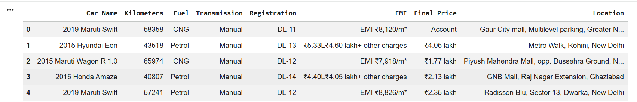
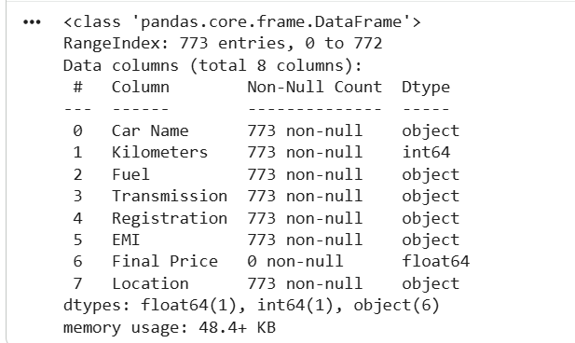
Dataset Overview

Slide 6
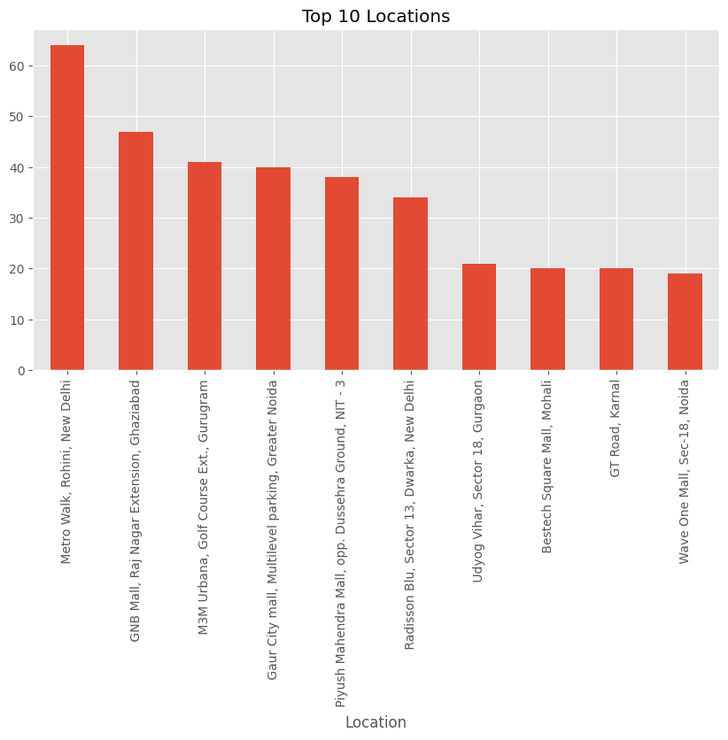
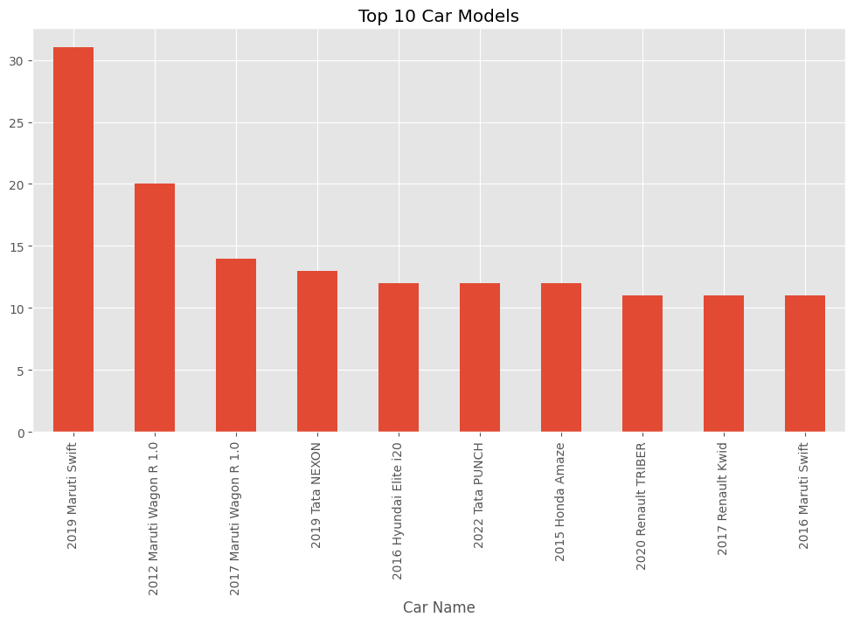
Area Wise Analysis

Slide 7
Brand Wise Analysis

Slide 8
Conclusion
Key Insights
Successfully scraped Cars24 data.
Performed area-wise analysis.
Performed brand-wise analysis.
Generated visual insights.
Future Scope
Price prediction model.
Machine learning recommendations.
Real-time dashboard.

